Slide 1
SNC 1DI
Practice Exam

Slide 2
Decide if the sentence is true or false. If the sentence is false, rewrite it to make it correct.
(a) Physical changes result in the formation of new substances.

Slide 3
Decide if the sentence is true or false. If the sentence is false, rewrite it to make it correct.
(a) Physical changes result in the formation of new substances.
False - chemical changes result in a new substance

Slide 4
Decide if the sentence is true or false. If the sentence is false, rewrite it to make it correct.
(a) Physical changes result in the formation of new substances.
False - chemical changes result in a new substance
(b) A chemical property of salt is that it forms white crystals in the shape of a cube.

Slide 5
Decide if the sentence is true or false. If the sentence is false, rewrite it to make it correct.
(a) Physical changes result in the formation of new substances.
False - chemical changes result in a new substance
(b) A chemical property of salt is that it forms white crystals in the shape of a cube.
False - a physical property of salt is that it forms white crystals in the shape of a cube

Slide 6
Decide if the sentence is true or false. If the sentence is false, rewrite it to make it correct.
(a) Physical changes result in the formation of new substances.
False - chemical changes result in a new substance
(b) A chemical property of salt is that it forms white crystals in the shape of a cube.
False - a physical property of salt is that it forms white crystals in the shape of a cube
(c) The formation of dew is a physical change.

Slide 7
Decide if the sentence is true or false. If the sentence is false, rewrite it to make it correct.
(a) Physical changes result in the formation of new substances.
False - chemical changes result in a new substance
(b) A chemical property of salt is that it forms white crystals in the shape of a cube.
False - a physical property of salt is that it forms white crystals in the shape of a cube
(c) The formation of dew is a physical change.
True

Slide 8
Decide if the sentence is true or false. If the sentence is false, rewrite it to make it correct.
(a) Physical changes result in the formation of new substances.
False - chemical changes result in a new substance
(b) A chemical property of salt is that it forms white crystals in the shape of a cube.
False - a physical property of salt is that it forms white crystals in the shape of a cube
(c) The formation of dew is a physical change.
True
(d) Non-metals are usually malleable and ductile.

Slide 9
Decide if the sentence is true or false. If the sentence is false, rewrite it to make it correct.
(a) Physical changes result in the formation of new substances.
False - chemical changes result in a new substance
(b) A chemical property of salt is that it forms white crystals in the shape of a cube.
False - a physical property of salt is that it forms white crystals in the shape of a cube
(c) The formation of dew is a physical change.
True
(d) Non-metals are usually malleable and ductile.
False - metals are usually malleable and ductile

Slide 10
Decide if the sentence is true or false. If the sentence is false, rewrite it to make it correct.
(a) Physical changes result in the formation of new substances.
False - chemical changes result in a new substance
(b) A chemical property of salt is that it forms white crystals in the shape of a cube.
False - a physical property of salt is that it forms white crystals in the shape of a cube
(c) The formation of dew is a physical change.
True
(d) Non-metals are usually malleable and ductile.
False - metals are usually malleable and ductile
(e) The starting substances in a reaction are called the products.

Slide 11
Decide if the sentence is true or false. If the sentence is false, rewrite it to make it correct.
(a) Physical changes result in the formation of new substances.
False - chemical changes result in a new substance
(b) A chemical property of salt is that it forms white crystals in the shape of a cube.
False - a physical property of salt is that it forms white crystals in the shape of a cube
(c) The formation of dew is a physical change.
True
(d) Non-metals are usually malleable and ductile.
False - metals are usually malleable and ductile
(e) The starting substances in a reaction are called the products.
False - the end substances in a reaction are called the products

Slide 12
Decide if the sentence is true or false. If the sentence is false, rewrite it to make it correct.
(a) Physical changes result in the formation of new substances.
False - chemical changes result in a new substance
(b) A chemical property of salt is that it forms white crystals in the shape of a cube.
False - a physical property of salt is that it forms white crystals in the shape of a cube
(c) The formation of dew is a physical change.
True
(d) Non-metals are usually malleable and ductile.
False - metals are usually malleable and ductile
(e) The starting substances in a reaction are called the products.
False - the end substances in a reaction are called the products
(f) To determine the density of a sample of material, you must measure the mass and volume of the sample.

Slide 13
Decide if the sentence is true or false. If the sentence is false, rewrite it to make it correct.
(a) Physical changes result in the formation of new substances.
False - chemical changes result in a new substance
(b) A chemical property of salt is that it forms white crystals in the shape of a cube.
False - a physical property of salt is that it forms white crystals in the shape of a cube
(c) The formation of dew is a physical change.
True
(d) Non-metals are usually malleable and ductile.
False - metals are usually malleable and ductile
(e) The starting substances in a reaction are called the products.
False - the end substances in a reaction are called the products
(f) To determine the density of a sample of material, you must measure the mass and volume of the sample.
False - to determine the density of a substance you must divide the mass of a substance by its volume

Slide 14
Label each of the following properties as physical or chemical.
(a) Copper sulphate crystals are blue

Slide 15
Label each of the following properties as physical or chemical.
(a) Copper sulphate crystals are blue. physical

Slide 16
Label each of the following properties as physical or chemical.
(a) Copper sulphate crystals are blue. physical
(b) Gold is an excellent conductor of electricity.

Slide 17
Label each of the following properties as physical or chemical.
(a) Copper sulphate crystals are blue. physical
(b) Gold is an excellent conductor of electricity. physical

Slide 18
Label each of the following properties as physical or chemical.
(a) Copper sulphate crystals are blue. physical
(b) Gold is an excellent conductor of electricity. physical
(c) Iron rusts when exposed to air and water

Slide 19
Label each of the following properties as physical or chemical.
(a) Copper sulphate crystals are blue. physical
(b) Gold is an excellent conductor of electricity. physical
(c) Iron rusts when exposed to air and water. chemical

Slide 20
Label each of the following properties as physical or chemical.
(a) Copper sulphate crystals are blue. physical
(b) Gold is an excellent conductor of electricity. physical
(c) Iron rusts when exposed to air and water. chemical
(d) Salt is soluble in water.

Slide 21
Label each of the following properties as physical or chemical.
(a) Copper sulphate crystals are blue. physical
(b) Gold is an excellent conductor of electricity. physical
(c) Iron rusts when exposed to air and water. chemical
(d) Salt is soluble in water. physical

Slide 22
Label each of the following properties as physical or chemical.
(a) Copper sulphate crystals are blue. physical
(b) Gold is an excellent conductor of electricity. physical
(c) Iron rusts when exposed to air and water. chemical
(d) Salt is soluble in water. physical
(e) Calcium reacts with water to produce hydrogen

Slide 23
Label each of the following properties as physical or chemical.
(a) Copper sulphate crystals are blue. physical
(b) Gold is an excellent conductor of electricity. physical
(c) Iron rusts when exposed to air and water. chemical
(d) Salt is soluble in water. physical
(e) Calcium reacts with water to produce hydrogen. chemical

Slide 24
Label each of the following properties as physical or chemical.
(a) Copper sulphate crystals are blue. physical
(b) Gold is an excellent conductor of electricity. physical
(c) Iron rusts when exposed to air and water. chemical
(d) Salt is soluble in water. physical
(e) Calcium reacts with water to produce hydrogen. chemical
(f) Gasoline burns in an automobile engine

Slide 25
Label each of the following properties as physical or chemical.
(a) Copper sulphate crystals are blue. physical
(b) Gold is an excellent conductor of electricity. physical
(c) Iron rusts when exposed to air and water. chemical
(d) Salt is soluble in water. physical
(e) Calcium reacts with water to produce hydrogen. chemical
(f) Gasoline burns in an automobile engine. chemical

Slide 26
The density of aluminum is 2.7 g/cm³. Four students each measured the mass and volume of a sample of metal; their results are shown below. Only one of the students actually had a sample of aluminum; the other students had different materials. From the information given, decide which student had the aluminum.
(a) mass = 28.4 g volume = 76.7 cm³
(b) mass = 37.4 g volume = 15.1 cm³
(c) mass = 88.3 g volume = 30.2 cm³
(d) mass = 76.7 g volume = 28.4 cm³

Slide 27
The density of aluminum is 2.7 g/cm³. Four students each measured the mass and volume of a sample of metal; their results are shown below. Only one of the students actually had a sample of aluminum; the other students had different materials. From the information given, decide which student had the aluminum.
(a) mass = 28.4 g volume = 76.7 cm³
(b) mass = 37.4 g volume = 15.1 cm³
(c) mass = 88.3 g volume = 30.2 cm³
(d) mass = 76.7 g volume = 28.4 cm³

Slide 28
The density of silver is 10.5 g/cm³. If you had a piece of silver with a mass of 458 g, what would the volume of the piece of silver be?
(a) 0.022 cm³
(b) 43.6 cm³
(c) 447.5 cm³
(d) 468.5 cm³

Slide 29
The density of silver is 10.5 g/cm³. If you had a piece of silver with a mass of 458 g, what would the volume of the piece of silver be?
(a) 0.022 cm³
(b) 43.6 cm³
(c) 447.5 cm³
(d) 468.5 cm³

Slide 30
Which of the following lists of properties is characteristic of metals?
(a) Shiny, brittle, conduct heat and electricity.
(b) Shiny, malleable, conduct heat and electricity.
(c) Shiny, malleable, do not conduct heat and electricity.
(d) Shiny, malleable, conduct heat but not electricity.

Slide 31
Which of the following lists of properties is characteristic of metals?
(a) Shiny, brittle, conduct heat and electricity.
(b) Shiny, malleable, conduct heat and electricity.
(c) Shiny, malleable, do not conduct heat and electricity.
(d) Shiny, malleable, conduct heat but not electricity.

Slide 32
State whether each of the following changes is a physical change or a chemical change. Give a reason for your answer in each case.
(a) The snow on the sidewalk outside your house melts.

Slide 33
State whether each of the following changes is a physical change or a chemical change. Give a reason for your answer in each case.
(a) The snow on the sidewalk outside your house melts.
physical - change in state

Slide 34
State whether each of the following changes is a physical change or a chemical change. Give a reason for your answer in each case.
(a) The snow on the sidewalk outside your house melts.
physical - change in state
(b) A piece of silverware gradually tarnishes when left exposed to air.

Slide 35
State whether each of the following changes is a physical change or a chemical change. Give a reason for your answer in each case.
(a) The snow on the sidewalk outside your house melts.
physical - change in state
(b) A piece of silverware gradually tarnishes when left exposed to air.
chemical - new colour formed

Slide 36
State whether each of the following changes is a physical change or a chemical change. Give a reason for your answer in each case.
(a) The snow on the sidewalk outside your house melts.
physical - change in state
(b) A piece of silverware gradually tarnishes when left exposed to air.
chemical - new colour formed
(c) Milk turns sour after several days.

Slide 37
State whether each of the following changes is a physical change or a chemical change. Give a reason for your answer in each case.
(a) The snow on the sidewalk outside your house melts.
physical - change in state
(b) A piece of silverware gradually tarnishes when left exposed to air.
chemical - new colour formed
(c) Milk turns sour after several days.
chemical - new odour/taste produced therefore new substance made

Slide 38
State whether each of the following changes is a physical change or a chemical change. Give a reason for your answer in each case.
(a) The snow on the sidewalk outside your house melts.
physical - change in state
(b) A piece of silverware gradually tarnishes when left exposed to air.
chemical - new colour formed
(c) Milk turns sour after several days.
chemical - new odour/taste produced therefore new substance made
(d) The three sugar cubes that you add to your coffee disappear when you stir the coffee.

Slide 39
State whether each of the following changes is a physical change or a chemical change. Give a reason for your answer in each case.
(a) The snow on the sidewalk outside your house melts.
physical - change in state
(b) A piece of silverware gradually tarnishes when left exposed to air.
chemical - new colour formed
(c) Milk turns sour after several days.
chemical - new odour/taste produced therefore new substance made
(d) The three sugar cubes that you add to your coffee disappear when you stir the coffee.
physical - cubes dissolve in coffee (can still taste the sugar)

Slide 40
State whether each of the following changes is a physical change or a chemical change. Give a reason for your answer in each case.
(a) The snow on the sidewalk outside your house melts.
physical - change in state
(b) A piece of silverware gradually tarnishes when left exposed to air.
chemical - new colour formed
(c) Milk turns sour after several days.
chemical - new odour/taste produced therefore new substance made
(d) The three sugar cubes that you add to your coffee disappear when you stir the coffee.
physical - cubes dissolve in coffee (can still taste the sugar)
(e) You accidentally spill some bleach on your favourite blue shirt and end up with white stains on the shirt.

Slide 41
State whether each of the following changes is a physical change or a chemical change. Give a reason for your answer in each case.
(a) The snow on the sidewalk outside your house melts.
physical - change in state
(b) A piece of silverware gradually tarnishes when left exposed to air.
chemical - new colour formed
(c) Milk turns sour after several days.
chemical - new odour/taste produced therefore new substance made
(d) The three sugar cubes that you add to your coffee disappear when you stir the coffee.
physical - cubes dissolve in coffee (can still taste the sugar)
(e) You accidentally spill some bleach on your favourite blue shirt and end up with white stains on the shirt.
chemical - new colour produced

Slide 42
State whether each of the following changes is a physical change or a chemical change. Give a reason for your answer in each case.
(a) The snow on the sidewalk outside your house melts.
physical - change in state
(b) A piece of silverware gradually tarnishes when left exposed to air.
chemical - new colour formed
(c) Milk turns sour after several days.
chemical - new odour/taste produced therefore new substance made
(d) The three sugar cubes that you add to your coffee disappear when you stir the coffee.
physical - cubes dissolve in coffee (can still taste the sugar)
(e) You accidentally spill some bleach on your favourite blue shirt and end up with white stains on the shirt.
chemical - new colour produced
(f) To reconnect a loose wire in your computer, the technician melts some solder.

Slide 43
State whether each of the following changes is a physical change or a chemical change. Give a reason for your answer in each case.
(a) The snow on the sidewalk outside your house melts.
physical - change in state
(b) A piece of silverware gradually tarnishes when left exposed to air.
chemical - new colour formed
(c) Milk turns sour after several days.
chemical - new odour/taste produced therefore new substance made
(d) The three sugar cubes that you add to your coffee disappear when you stir the coffee.
physical - cubes dissolve in coffee (can still taste the sugar)
(e) You accidentally spill some bleach on your favourite blue shirt and end up with white stains on the shirt.
chemical - new colour produced
(f) To reconnect a loose wire in your computer, the technician melts some solder.
physical - solder changes state

Slide 44
When electricity is passed through water, a chemical reaction takes place. In this reaction
(a) the products are nitrogen and oxygen.
(b) the products are carbon dioxide and oxygen.
(c) the products are water and hydrogen peroxide.
(d) the products are hydrogen and oxygen.

Slide 45
When electricity is passed through water, a chemical reaction takes place. In this reaction
(a) the products are nitrogen and oxygen.
(b) the products are carbon dioxide and oxygen.
(c) the products are water and hydrogen peroxide.
(d) the products are hydrogen and oxygen.

Slide 46
Only one of the following lists does not consist entirely of symbols for elements. Which one?
(a) C, He, Mg, Cu
(b) H, ASA, P, Fe
(c) He, N, Cl, O
(d) Ca, Ne, Fe, He

Slide 47
Only one of the following lists does not consist entirely of symbols for elements. Which one?
(a) C, He, Mg, Cu
(b) H, ASA, P, Fe
(c) He, N, Cl, O
(d) Ca, Ne, Fe, He

Slide 48
The total number of atoms represented by the formula K₂Cr₂O₇ is
(a) 1
(b) 3
(c) 11
(d) 28

Slide 49
The total number of atoms represented by the formula K₂Cr₂O₇ is
(a) 1
(b) 3
(c) 11
(d) 28

Slide 50
Write symbols for the following elements that are found in living things.
Oxygen
Carbon
Hydrogen
Nitrogen
Phosphorus
Sulphur
Chlorine
Sodium
Potassium
Magnesium
Iodine
Calcium
Iron

Slide 51
Write symbols for the following elements that are found in living things.
Oxygen - O
Carbon
Hydrogen
Nitrogen
Phosphorus
Sulphur
Chlorine
Sodium
Potassium
Magnesium
Iodine
Calcium
Iron

Slide 52
Write symbols for the following elements that are found in living things.
Oxygen - O
Carbon - C
Hydrogen
Nitrogen
Phosphorus
Sulphur
Chlorine
Sodium
Potassium
Magnesium
Iodine
Calcium
Iron

Slide 53
Write symbols for the following elements that are found in living things.
Oxygen - O
Carbon - C
Hydrogen - H
Nitrogen
Phosphorus
Sulphur
Chlorine
Sodium
Potassium
Magnesium
Iodine
Calcium
Iron

Slide 54
Write symbols for the following elements that are found in living things.
Oxygen - O
Carbon - C
Hydrogen - H
Nitrogen - N
Phosphorus
Sulphur
Chlorine
Sodium
Potassium
Magnesium
Iodine
Calcium
Iron

Slide 55
Write symbols for the following elements that are found in living things.
Oxygen - O
Carbon - C
Hydrogen - H
Nitrogen - N
Phosphorus - P
Sulphur
Chlorine
Sodium
Potassium
Magnesium
Iodine
Calcium
Iron

Slide 56
Write symbols for the following elements that are found in living things.
Oxygen - O
Carbon - C
Hydrogen - H
Nitrogen - N
Phosphorus - P
Sulphur - S
Chlorine
Sodium
Potassium
Magnesium
Iodine
Calcium
Iron

Slide 57
Write symbols for the following elements that are found in living things.
Oxygen - O
Carbon - C
Hydrogen - H
Nitrogen - N
Phosphorus - P
Sulphur - S
Chlorine - Cl
Sodium
Potassium
Magnesium
Iodine
Calcium
Iron

Slide 58
Write symbols for the following elements that are found in living things.
Oxygen - O
Carbon - C
Hydrogen - H
Nitrogen - N
Phosphorus - P
Sulphur - S
Chlorine - Cl
Sodium - Na
Potassium
Magnesium
Iodine
Calcium
Iron

Slide 59
Write symbols for the following elements that are found in living things.
Oxygen - O
Carbon - C
Hydrogen - H
Nitrogen - N
Phosphorus - P
Sulphur - S
Chlorine - Cl
Sodium - Na
Potassium - K
Magnesium
Iodine
Calcium
Iron

Slide 60
Write symbols for the following elements that are found in living things.
Oxygen - O
Carbon - C
Hydrogen - H
Nitrogen - N
Phosphorus - P
Sulphur - S
Chlorine - Cl
Sodium - Na
Potassium - K
Magnesium - Mg
Iodine
Calcium
Iron

Slide 61
Write symbols for the following elements that are found in living things.
Oxygen - O
Carbon - C
Hydrogen - H
Nitrogen - N
Phosphorus - P
Sulphur - S
Chlorine - Cl
Sodium - Na
Potassium - K
Magnesium - Mg
Iodine - I
Calcium
Iron

Slide 62
Write symbols for the following elements that are found in living things.
Oxygen - O
Carbon - C
Hydrogen - H
Nitrogen - N
Phosphorus - P
Sulphur - S
Chlorine - Cl
Sodium - Na
Potassium - K
Magnesium - Mg
Iodine - I
Calcium - Ca
Iron

Slide 63
Write symbols for the following elements that are found in living things.
Oxygen - O
Carbon - C
Hydrogen - H
Nitrogen - N
Phosphorus - P
Sulphur - S
Chlorine - Cl
Sodium - Na
Potassium - K
Magnesium - Mg
Iodine - I
Calcium - Ca
Iron - Fe

Slide 64
Protons are
(a) positively charged particles found outside the nucleus in an atom.
(b) negatively charged particles found outside the nucleus in an atom.
(c) neutral particles found in the nucleus in an atom.
(d) positively charged particles found in the nucleus in an atom.

Slide 65
Protons are
(a) positively charged particles found outside the nucleus in an atom.
(b) negatively charged particles found outside the nucleus in an atom.
(c) neutral particles found in the nucleus in an atom.
(d) positively charged particles found in the nucleus in an atom.

Slide 66
Electrons are
(a) positively charged particles found outside the nucleus in an atom.
(b) negatively charged particles found outside the nucleus in an atom.
(c) neutral particles found in the nucleus in an atom.
(d) negatively charged particles found in the nucleus in an atom.

Slide 67
Electrons are
(a) positively charged particles found outside the nucleus in an atom.
(b) negatively charged particles found outside the nucleus in an atom.
(c) neutral particles found in the nucleus in an atom.
(d) negatively charged particles found in the nucleus in an atom.

Slide 68
Neutrons are
(a) negatively charged particles found outside the nucleus in an atom.
(b) neutral particles found outside the nucleus in an atom.
(c) neutral particles found in the nucleus in an atom.
(d) positively charged particles found in the nucleus in an atom.

Slide 69
Neutrons are
(a) negatively charged particles found outside the nucleus in an atom.
(b) neutral particles found outside the nucleus in an atom.
(c) neutral particles found in the nucleus in an atom.
(d) positively charged particles found in the nucleus in an atom.

Slide 70
In Bohr's planetary model of the atom, he suggested that
(a) electrons could be found only in certain orbits or energy levels.
(b) the closer an electron is to the nucleus, the higher its energy.
(c) electrons always stay in the same energy level.
(d) the orbit closest to the nucleus can hold eight electrons.

Slide 71
In Bohr's planetary model of the atom, he suggested that
(a) electrons could be found only in certain orbits or energy levels.
(b) the closer an electron is to the nucleus, the higher its energy.
(c) electrons always stay in the same energy level.
(d) the orbit closest to the nucleus can hold eight electrons.

Slide 72
In which group of the periodic table are the halogens found?
(a) 1
(b) 2
(c) 7
(d) 8

Slide 73
In which group of the periodic table are the halogens found?
(a) 1
(b) 2
(c) 7
(d) 8

Slide 74
In which group of the periodic table are the alkali metals found?
(a) 1
(b) 2
(c) 7
(d) 8

Slide 75
In which group of the periodic table are the alkali metals found?
(a) 1
(b) 2
(c) 7
(d) 8

Slide 76
Which group in the periodic table contains the noble gases?
(a) 1
(b) 2
(c) 7
(d) 8

Slide 77
Which group in the periodic table contains the noble gases?
(a) 1
(b) 2
(c) 7
(d) 8

Slide 78
The most metallic elements in the periodic table are found:
(a) on the extreme right of the table
(b) on the extreme left of the table
(c) in the middle of the table
(d) in the second column

Slide 79
The most metallic elements in the periodic table are found:
(a) on the extreme right of the table
(b) on the extreme left of the table
(c) in the middle of the table
(d) in the second column

Slide 80
Rows in the periodic table are also referred to as
(a) periods.
(b) families.
(c) groups.
(d) columns.

Slide 81
Rows in the periodic table are also referred to as
(a) periods.
(b) families.
(c) groups.
(d) columns.

Slide 82
Draw Bohr-Rutherford diagrams for the following elements:
Be (AN = 4, MN = 9.01)
Si (AN = 14, MN = 28.0)
Ar (AN, 18, MN = 39.9)

Slide 83
Draw Bohr-Rutherford diagrams for the following elements:
Be (AN = 4, MN = 9.01)
P = 4, e = 4, n = 5

Slide 84
Draw Bohr-Rutherford diagrams for the following elements:
Si (AN = 14, MN = 28.0)
P = 14, e = 14, n = 14

Slide 85
Draw Bohr-Rutherford diagrams for the following elements:
Ar (AN, 18, MN = 39.9)
P = 18, e = 18, n = 22

Slide 86
Explain why Canadians enjoy earlier sunrises in July than in January. Write your answer in complete sentences.

Slide 87
Explain why Canadians enjoy earlier sunrises in July than in January. Write your answer in complete sentences.
The days are longer due to the fact that we get more direct sunlight in the summer.
The sun is in the sky for a longer period of time.
Because the days are longer the Sun rises earlier and sets later

Slide 88
The year is based on ...
(a) the Earth's rotation
(b) the Earth's revolution
(c) the Moon's revolution
(d) the Sun's rotation

Slide 89
The year is based on ...
(a) the Earth's rotation
(b) the Earth's revolution
(c) the Moon's revolution
(d) the Sun's rotation

Slide 90
Prepare a diagram that explains the factors responsible for our seasons.

Slide 91
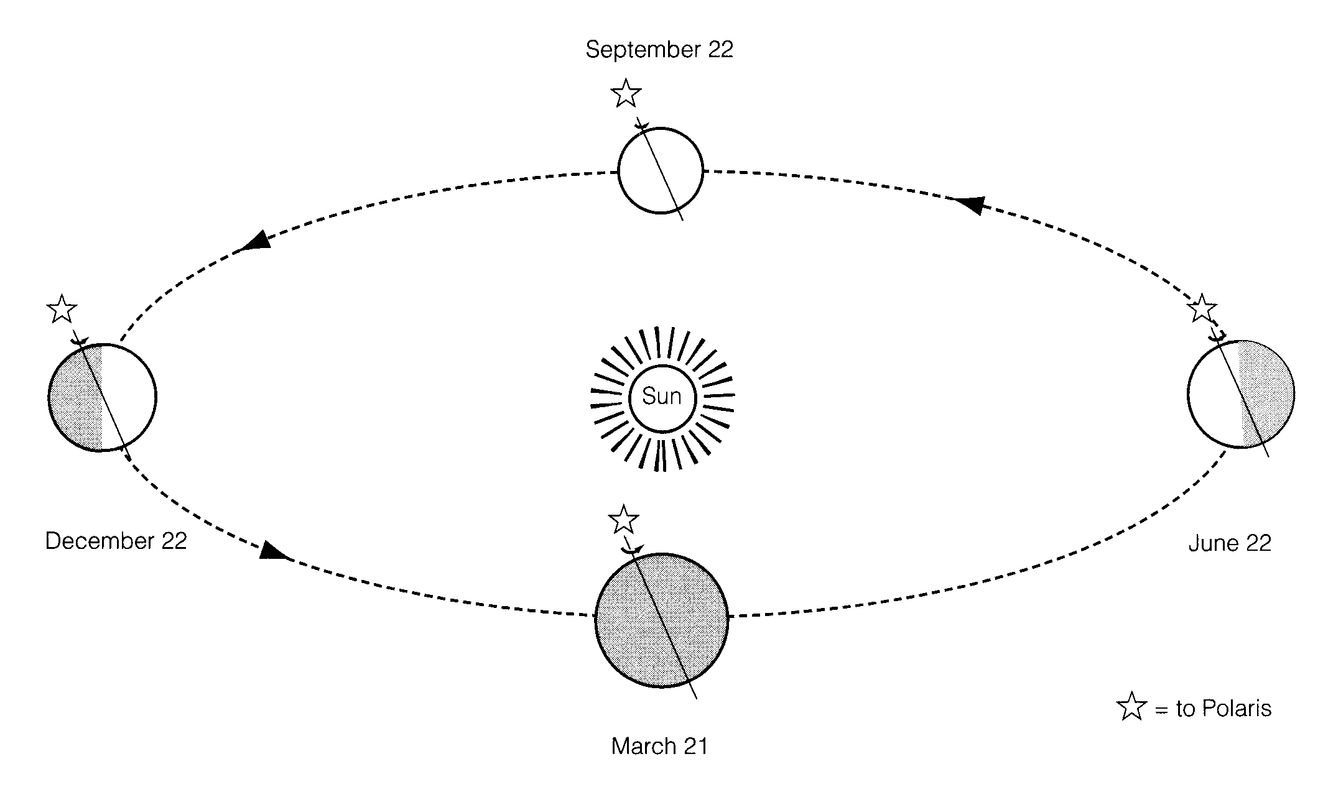
Prepare a diagram that explains the factors responsible for our seasons.

Slide 92
Choose the planet that is completely different from the other three.
(a) Jupiter
(b) Neptune
(c) Mars
(d) Saturn

Slide 93
Choose the planet that is completely different from the other three.
(a) Jupiter
(b) Neptune
(c) Mars
(d) Saturn

Slide 94
Arrange the following planets in order of size from smallest to largest: Jupiter, Earth, Mars, Neptune.

Slide 95
Arrange the following planets in order of size from smallest to largest: Jupiter, Earth, Mars, Neptune.
Mars, Earth, Neptune, Jupiter

Slide 96
From the list given, choose the planet that has rings around it.
(a) Pluto
(b) Mercury
(c) Mars
(d) Jupiter

Slide 97
From the list given, choose the planet that has rings around it.
(a) Pluto
(b) Mercury
(c) Mars
(d) Jupiter

Slide 98
Which of the following statements describes a galaxy?
(a) A galaxy consists of our Sun and all major planets.
(b) A galaxy consists of our entire solar system and all the stars we can see.
(c) A galaxy consists of about 200 billion stars, dust, gas, and solid matter that may form planets.
(d) A galaxy consists of all the matter in the universe.

Slide 99
Which of the following statements describes a galaxy?
(a) A galaxy consists of our Sun and all major planets.
(b) A galaxy consists of our entire solar system and all the stars we can see.
(c) A galaxy consists of about 200 billion stars, dust, gas, and solid matter that may form planets.
(d) A galaxy consists of all the matter in the universe.

Slide 100
What object is most likely the birthplace of stars?
(a) Black hole.
(b) Supernova.
(c) Nebula.
(d) Neutron star.

Slide 101
What object is most likely the birthplace of stars?
(a) Black hole.
(b) Supernova.
(c) Nebula.
(d) Neutron star.

Slide 102
Write a paragraph explaining how a cloud of dust and gas can eventually form a star. Include diagrams in your answer.

Slide 103
Write a paragraph explaining how a cloud of dust and gas can eventually form a star. Include diagrams in your answer.
spaces between stars is filled with gas and dust

Slide 104
Write a paragraph explaining how a cloud of dust and gas can eventually form a star. Include diagrams in your answer.
spaces between stars is filled with gas and dust
a dense area is called a Nebula mostly Hydrogen

Slide 105
Write a paragraph explaining how a cloud of dust and gas can eventually form a star. Include diagrams in your answer.
spaces between stars is filled with gas and dust
a dense area is called a Nebula mostly Hydrogen
gravity pulls everything together and the gas and dust collapse everything is pulled towards the middle

Slide 106
Write a paragraph explaining how a cloud of dust and gas can eventually form a star. Include diagrams in your answer.
spaces between stars is filled with gas and dust
a dense area is called a Nebula mostly Hydrogen
gravity pulls everything together and the gas and dust collapse everything is pulled towards the middle
the cloud spins faster and faster

Slide 107
Write a paragraph explaining how a cloud of dust and gas can eventually form a star. Include diagrams in your answer.
spaces between stars is filled with gas and dust
a dense area is called a Nebula mostly Hydrogen
gravity pulls everything together and the gas and dust collapse everything is pulled towards the middle
the cloud spins faster and faster
more hydrogen builds up in the center same idea as a figure skater drawing their arms inwards as they spin

Slide 108
Write a paragraph explaining how a cloud of dust and gas can eventually form a star. Include diagrams in your answer.
spaces between stars is filled with gas and dust
a dense area is called a Nebula mostly Hydrogen
gravity pulls everything together and the gas and dust collapse everything is pulled towards the middle
the cloud spins faster and faster
more hydrogen builds up in the center same idea as a figure skater drawing their arms inwards as they spin
the large build up of gas in the center will become the star cloud flattens into a disk due to the spinning

Slide 109
Write a paragraph explaining how a cloud of dust and gas can eventually form a star. Include diagrams in your answer.
spaces between stars is filled with gas and dust
a dense area is called a Nebula mostly Hydrogen
gravity pulls everything together and the gas and dust collapse everything is pulled towards the middle
the cloud spins faster and faster
more hydrogen builds up in the center same idea as a figure skater drawing their arms inwards as they spin
the large build up of gas in the center will become the star cloud flattens into a disk due to the spinning
little pockets of gas accumulate and spin in the same direction as the cloud (will form planets) as the gases in the center compress the temperature rises to 10 000 000 ºC and the star will ignite

Slide 110
Write a paragraph explaining how a cloud of dust and gas can eventually form a star. Include diagrams in your answer.
spaces between stars is filled with gas and dust
a dense area is called a Nebula mostly Hydrogen
gravity pulls everything together and the gas and dust collapse everything is pulled towards the middle
the cloud spins faster and faster
more hydrogen builds up in the center same idea as a figure skater drawing their arms inwards as they spin
the large build up of gas in the center will become the star cloud flattens into a disk due to the spinning
little pockets of gas accumulate and spin in the same direction as the cloud (will form planets) as the gases in the center compress the temperature rises to 10 000 000 ºC and the star will ignite
solar winds from the new star blow away most of the hydrogen and helium from the inner regions leaving chunks of heavy matter

Slide 111
Write a paragraph explaining how a cloud of dust and gas can eventually form a star. Include diagrams in your answer.
spaces between stars is filled with gas and dust
a dense area is called a Nebula mostly Hydrogen
gravity pulls everything together and the gas and dust collapse everything is pulled towards the middle
the cloud spins faster and faster
more hydrogen builds up in the center same idea as a figure skater drawing their arms inwards as they spin
the large build up of gas in the center will become the star cloud flattens into a disk due to the spinning
little pockets of gas accumulate and spin in the same direction as the cloud (will form planets) as the gases in the center compress the temperature rises to 10 000 000 ºC and the star will ignite
solar winds from the new star blow away most of the hydrogen and helium from the inner regions leaving chunks of heavy matter
these chunks keep colliding with each other and grow in size to become planetismals and eventually the inner planets

Slide 112
Write a paragraph explaining how a cloud of dust and gas can eventually form a star. Include diagrams in your answer.
spaces between stars is filled with gas and dust
a dense area is called a Nebula mostly Hydrogen
gravity pulls everything together and the gas and dust collapse everything is pulled towards the middle
the cloud spins faster and faster
more hydrogen builds up in the center same idea as a figure skater drawing their arms inwards as they spin
the large build up of gas in the center will become the star cloud flattens into a disk due to the spinning
little pockets of gas accumulate and spin in the same direction as the cloud (will form planets) as the gases in the center compress the temperature rises to 10 000 000 ºC and the star will ignite
solar winds from the new star blow away most of the hydrogen and helium from the inner regions leaving chunks of heavy matter
these chunks keep colliding with each other and grow in size to become planetismals and eventually the inner planets
lighter more volatile elements (Hydrogen, Helium) are distributed in the outer regions forming the outer planets remaining matter makes up asteroids, meteors and comets

Slide 113
What are the two most common elements found on the Sun?
What role do they play in the energy-production mechanism of the Sun?

Slide 114
What are the two most common elements found on the Sun?
hydrogen and helium
What role do they play in the energy-production mechanism of the Sun?

Slide 115
What are the two most common elements found on the Sun?
hydrogen and helium
What role do they play in the energy-production mechanism of the Sun?
In the center of the Sun, hydrogen is being converted to helium by the process of fusion.
This is the energy production process of our star.

Slide 116
The colour of a star depends on its
(a) temperature.
(b) size.
(c) distance.
(d) position.

Slide 117
The colour of a star depends on its
(a) temperature.
(b) size.
(c) distance.
(d) position.

Slide 118
Which of the following is a biotic factor?
(a) temperature
(b) sunlight
(c) energy
(d) decomposers

Slide 119
Which of the following is a biotic factor?
(a) temperature
(b) sunlight
(c) energy
(d) decomposers

Slide 120
Which of the following is NOT recycled in an ecosystem?
(a) water
(b) energy
(c) carbon
(d) nitrogen

Slide 121
Which of the following is NOT recycled in an ecosystem?
(a) water
(b) energy
(c) carbon
(d) nitrogen

Slide 122
What is the maximum number of individuals that can live in an area without harming the environment?
(a) carrying capacity
(b) steady state
(c) climax community
(d) population density

Slide 123
What is the maximum number of individuals that can live in an area without harming the environment?
(a) carrying capacity
(b) steady state
(c) climax community
(d) population density

Slide 124
Which of the following organisms would be most affected by
bio-magnification?
(a) frog
(b) hawk
(c) snake
(d) grasshopper

Slide 125
Which of the following organisms would be most affected by
bio-magnification?
(a) frog
(b) hawk
(c) snake
(d) grasshopper

Slide 126
Consider the following food web:
shark killer whale
kingfisher sealion
codfish salmon
shrimp minnows
plankton
(a) List the organisms in the second tropic level.

Slide 127
Consider the following food web:
shark killer whale
kingfisher sealion
codfish salmon
shrimp minnows
plankton
List the organisms in the second tropic level.
shrimp, minnow

Slide 128
Consider the following food web:
shark killer whale
kingfisher sealion
codfish salmon
shrimp minnows
plankton
(b) List two things that are missing which are a key part of any food web.

Slide 129
Consider the following food web:
shark killer whale
kingfisher sealion
codfish salmon
shrimp minnows
plankton
(b) List two things that are missing which are a key part of any food web.
the Sun, decomposers

Slide 130
Consider the following food web:
shark killer whale
kingfisher sealion
codfish salmon
shrimp minnows
plankton
(c) What would happen to the sea lion population if all of the kingfishers were removed?

Slide 131
Consider the following food web:
shark killer whale
kingfisher sealion
codfish salmon
shrimp minnows
plankton
(c) What would happen to the sea lion population if all of the kingfishers were removed?
The population of sealions would increase because more food (codfish) would be available

Slide 132
Consider the following food web:
shark killer whale
kingfisher sealion
codfish salmon
shrimp minnows
plankton
(d) Name the trophic level and consumer order of the killer whale.

Slide 133
Consider the following food web:
shark killer whale
kingfisher sealion
codfish salmon
shrimp minnows
plankton
(d) Name the trophic level and consumer order of the killer whale.
5th Trophic level
Top carnivore or 4th order consumer

Slide 134
Consider the following food web:
shark killer whale
kingfisher sealion
codfish salmon
shrimp minnows
plankton
(e) What organism would you expect to be most affected by a chemical pesticide found in the ocean?

Slide 135
Consider the following food web:
shark killer whale
kingfisher sealion
codfish salmon
shrimp minnows
plankton
(e) What organism would you expect to be most affected by a chemical pesticide found in the ocean?
Killer Whale

Slide 136
In an attempt to get a lush, green weed-free lawn, a person applies some weed killer to their lawn. Suppose each blade of grass absorbs 5 units of pesticide. Grasshoppers eat 15 blades of grass per day. A bird eats 3 grasshoppers per day. SHOW YOUR WORK.
A) How much pesticide would a grasshopper have accumulated after one month (30 days)?

Slide 137
In an attempt to get a lush, green weed-free lawn, a person applies some weed killer to their lawn. Suppose each blade of grass absorbs 5 units of pesticide. Grasshoppers eat 15 blades of grass per day. A bird eats 3 grasshoppers per day. SHOW YOUR WORK.
How much pesticide would a grasshopper have accumulated after one month (30 days)?
= (grass) 5 units x (grasshopper) 15 blades x 30 days
blade day month
= 2250 units
month

Slide 138
In an attempt to get a lush, green weed-free lawn, a person applies some weed killer to their lawn. Suppose each blade of grass absorbs 5 units of pesticide. Grasshoppers eat 15 blades of grass per day. A bird eats 3 grasshoppers per day. SHOW YOUR WORK.
B) How much pesticide would the bird have accumulated after one month? Six months?

Slide 139
In an attempt to get a lush, green weed-free lawn, a person applies some weed killer to their lawn. Suppose each blade of grass absorbs 5 units of pesticide. Grasshoppers eat 15 blades of grass per day. A bird eats 3 grasshoppers per day. SHOW YOUR WORK.
B) How much pesticide would the bird have accumulated after one month? Six months?
One Month = 5 units in one blade x 15 blades eaten by grasshopper in one day x 3 grasshoppers eaten by bird in one day
x 30 days in month
= 6750 units/month

Slide 140
In an attempt to get a lush, green weed-free lawn, a person applies some weed killer to their lawn. Suppose each blade of grass absorbs 5 units of pesticide. Grasshoppers eat 15 blades of grass per day. A bird eats 3 grasshoppers per day. SHOW YOUR WORK.
B) How much pesticide would the bird have accumulated after one month? Six months?
One Month = 6750 units/month
Six Months = 6750 units/month x 6 months
= 40 500 units

Slide 141
Match each of the following terms with the proper description.
Match | Description | Term
 | Eats only plants | (A) omnivore
 | Eats only animals | (B) decomposer
 | Bacteria or fungi | (C) carnivore
 | Eats both plants and animals | (D) herbivore
 | Part of Earth where all life exists | (E) hydrosphere
 | Part of Earth covered by water | (F) biosphere

Slide 142
Match each of the following terms with the proper description.
Match | Description | Term
D | Eats only plants | (A) omnivore
 | Eats only animals | (B) decomposer
 | Bacteria or fungi | (C) carnivore
 | Eats both plants and animals | (D) herbivore
 | Part of Earth where all life exists | (E) hydrosphere
 | Part of Earth covered by water | (F) biosphere

Slide 143
Match each of the following terms with the proper description.
Match | Description | Term
D | Eats only plants | (A) omnivore
C | Eats only animals | (B) decomposer
 | Bacteria or fungi | (C) carnivore
 | Eats both plants and animals | (D) herbivore
 | Part of Earth where all life exists | (E) hydrosphere
 | Part of Earth covered by water | (F) biosphere

Slide 144
Match each of the following terms with the proper description.
Match | Description | Term
D | Eats only plants | (A) omnivore
C | Eats only animals | (B) decomposer
B | Bacteria or fungi | (C) carnivore
 | Eats both plants and animals | (D) herbivore
 | Part of Earth where all life exists | (E) hydrosphere
 | Part of Earth covered by water | (F) biosphere

Slide 145
Match each of the following terms with the proper description.
Match | Description | Term
D | Eats only plants | (A) omnivore
C | Eats only animals | (B) decomposer
B | Bacteria or fungi | (C) carnivore
A | Eats both plants and animals | (D) herbivore
 | Part of Earth where all life exists | (E) hydrosphere
 | Part of Earth covered by water | (F) biosphere

Slide 146
Match each of the following terms with the proper description.
Match | Description | Term
D | Eats only plants | (A) omnivore
C | Eats only animals | (B) decomposer
B | Bacteria or fungi | (C) carnivore
A | Eats both plants and animals | (D) herbivore
F | Part of Earth where all life exists | (E) hydrosphere
 | Part of Earth covered by water | (F) biosphere

Slide 147
Match each of the following terms with the proper description.
Match | Description | Term
D | Eats only plants | (A) omnivore
C | Eats only animals | (B) decomposer
B | Bacteria or fungi | (C) carnivore
A | Eats both plants and animals | (D) herbivore
F | Part of Earth where all life exists | (E) hydrosphere
E | Part of Earth covered by water | (F) biosphere

Slide 148
(a) How is carbon dioxide removed from the atmosphere?
(b) How is carbon dioxide put into the atmosphere?

Slide 149
How is carbon dioxide removed from the atmosphere?
Carbon dioxide is removed through the process of photosynthesis
(b) How is carbon dioxide put into the atmosphere?

Slide 150
How is carbon dioxide removed from the atmosphere?
Carbon dioxide is removed through the process of photosynthesis
(b) How is carbon dioxide put into the atmosphere?
Carbon dioxide is put into the atmosphere through cellular respiration
burning fossil fuels

Slide 151
(a) Why are increasing levels of carbon dioxide a concern?
(b) What practical things can you do to reduce carbon dioxide emissions? (No, you can’t stop breathing!)

Slide 152
Why are increasing levels of carbon dioxide a concern?
Carbon dioxide is a greenhouse gas
The build up of carbon dioxide will prevent heat from leaving the atmosphere
(b) What practical things can you do to reduce carbon dioxide emissions? (No, you can’t stop breathing!)

Slide 153
Why are increasing levels of carbon dioxide a concern?
Carbon dioxide is a greenhouse gas
The build up of carbon dioxide will prevent heat from leaving the atmosphere
(b) What practical things can you do to reduce carbon dioxide emissions? (No, you can’t stop breathing!)
reduce burning of fossil fuels (clean transportation methods)
recycle
plant some trees

Slide 154
What is the term for using natural resources wisely so that they may be used forever?

Slide 155
What is the term for using natural resources wisely so that they may be used forever?
Sustainability of resources

Slide 156
Describe two (2) benefits of eating locally and eating fewer processed foods.

Slide 157
Describe two (2) benefits of eating locally and eating fewer processed foods.
less cost for transportation
less cost to produce and package the food
less chemicals to preserve the food

Slide 158
Which of the following is a density-dependent factor that may affect a population?
(a) forest fire
(b) flood
(c) disease
(d) tornado

Slide 159
Which of the following is a density-dependent factor that may affect a population?
(a) forest fire
(b) flood
(c) disease
(d) tornado

Slide 160
Where is most of the Earth’s carbon stored?
(a) ocean
(b) forests
(c) fossil fuels
(d) atmosphere

Slide 161
Where is most of the Earth’s carbon stored?
(a) ocean
(b) forests
(c) fossil fuels
(d) atmosphere

Slide 162
Which of the following is best evidence that the carrying capacity of an area has been reached?
(a) population stabilizes or decreases
(b) population grows gradually
(c) there are plenty of natural resources
(d) the population increases rapidly

Slide 163
Which of the following is best evidence that the carrying capacity of an area has been reached?
(a) population stabilizes or decreases
(b) population grows gradually
(c) there are plenty of natural resources
(d) the population increases rapidly

Slide 164
Most of the time in an ecosystem there are more…
(a) predators than prey
(b) prey than predators
(c) omnivores than herbivores
(d) prey than decomposers

Slide 165
Most of the time in an ecosystem there are more…
(a) predators than prey
(b) prey than predators
(c) omnivores than herbivores
(d) prey than decomposers

Slide 166
Which of the following is true about plants? Plants…
(a) use oxygen to make sugar
(b) use carbon dioxide to make sugar
(c) never produce carbon dioxide
(d) cause global warming

Slide 167
Which of the following is true about plants? Plants…
(a) use oxygen to make sugar
(b) use carbon dioxide to make sugar
(c) never produce carbon dioxide
(d) cause global warming

Slide 168
What term is given to a vulture that eats from the remains of a dead animal?
(a) scavenger
(b) parasite
(c) carnivore
(d) decomposer

Slide 169
What term is given to a vulture that eats from the remains of a dead animal?
(a) scavenger
(b) parasite
(c) carnivore
(d) decomposer

Slide 170
Consider the population numbers of Minnows and Oscar fish in a pond at Laurel Creek.
year | # Minnows | # Oscar fish
1970 | 35 | 20
1972 | 42 | 22
1974 | 55 | 28
1976 | 60 | 38
1978 | 52 | 46
1980 | 37 | 52
1982 | 20 | 55
1984 | 14 | 45
1986 | 20 | 30
1988 | 28 | 20
1990 | 35 | 16
1992 | 45 | 25
1994 | 50 | 32
1996 | 46 | 38
1998 | 40 | 35
2000 | 35 | 20

Slide 171
Using proper graphing technique, graph the populations of these creatures on the provided paper.
Use a different colour for each population (include a legend) and include an appropriate title for your graph.

Slide 172
Using proper graphing technique, graph the populations of these creatures on the provided paper. Use a different colour for each population (include a legend) and include an appropriate title for your graph.
Population numbers for Minnows and Oscar fish
# of animals
Minnows
Oscar fish
year

Slide 173
Which creature is the predator? ____________________
What evidence suggests this?

Slide 174
Which creature is the predator? Oscar fish
What evidence suggests this?

Slide 175
Which creature is the predator? Oscar fish
What evidence suggests this?
- their population trend follows that of the minnows

Slide 176
What would you expect to happen to the population of Oscar fish if the population of minnows went down, and why?

Slide 177
What would you expect to happen to the population of Oscar fish if the population of minnows went down, and why?
The population of Oscar fish would also decrease because they feed on the minnows.

Slide 178
Other than the predator-prey relationship, describe 2 factors that could account for the change in the population of minnows from 1976 to 1984:
1)
2)

Slide 179
Other than the predator-prey relationship, describe 2 factors that could account for the change in the population of minnows from 1976 to 1984:
1) Drought could cause their food supply to decrease
2)

Slide 180
Other than the predator-prey relationship, describe 2 factors that could account for the change in the population of minnows from 1976 to 1984:
1) Drought could cause their food supply to decrease
2) Disease could have hits the minnows and decreased their numbers.

Slide 181
When a plastic comb is rubbed with a piece of animal fur and is brought close to a fine stream of water from a tap, the stream of water will be
(a) attracted to the comb.
(b) repelled by the comb.
(c) unaffected by the comb.
(d) first attracted, then repelled.

Slide 182
When a plastic comb is rubbed with a piece of animal fur and is brought close to a fine stream of water from a tap, the stream of water will be
(a) attracted to the comb.
(b) repelled by the comb.
(c) unaffected by the comb.
(d) first attracted, then repelled.

Slide 183
Describe what would happen on a dry, cool day if you were to pet a long-haired cat for several seconds before reaching out to touch a metal doorknob. Why does this occur? Write your answer in complete sentences.

Slide 184
Describe what would happen on a dry, cool day if you were to pet a long-haired cat for several seconds before reaching out to touch a metal doorknob. Why does this occur? Write your answer in complete sentences.
while petting the cat an exchange of electrons occurs

Slide 185
Describe what would happen on a dry, cool day if you were to pet a long-haired cat for several seconds before reaching out to touch a metal doorknob. Why does this occur? Write your answer in complete sentences.
while petting the cat an exchange of electrons occurs
you become negative and the fur becomes positive

Slide 186
Describe what would happen on a dry, cool day if you were to pet a long-haired cat for several seconds before reaching out to touch a metal doorknob. Why does this occur? Write your answer in complete sentences.
while petting the cat an exchange of electrons occurs
you become negative and the fur becomes positive
you will build up a charge on your body that will be discharged if you touch a doorknob

Slide 187
Which of the following is a good conductor?
(a) silk
(b) sand
(c) salt water
(d) silver

Slide 188
Which of the following is a good conductor?
(a) silk
(b) sand
(c) salt water
(d) silver

Slide 189
When a negative rod is used to induce a charge on an object, there is a flow of:
electrons from the rod into the object.
protons from the rod into the object.
(c) electrons from the object to the ground.
(d) protons from the object to the ground.

Slide 190
When a negative rod is used to induce a charge on an object, there is a flow of:
electrons from the rod into the object.
protons from the rod into the object.
(c) electrons from the object to the ground.
(d) protons from the object to the ground.

Slide 191
You and a friend are standing in the middle of a football field as low-lying clouds begin to roll quickly into the area. You notice that your friend's hair suddenly begins to stand up. You feel that the same thing is happening to you. Even though it has not yet begun to rain, your friend shouts that you had better both get out of the area quickly because there will soon be lightning. Explain why hair standing up could be a warning sign of a lightning strike. Write your answer in complete sentences.

Slide 192
You and a friend are standing in the middle of a football field as low-lying clouds begin to roll quickly into the area. You notice that your friend's hair suddenly begins to stand up. You feel that the same thing is happening to you. Even though it has not yet begun to rain, your friend shouts that you had better both get out of the area quickly because there will soon be lightning. Explain why hair standing up could be a warning sign of a lightning strike. Write your answer in complete sentences.
a build up of charge is occurring on the ground

Slide 193
You and a friend are standing in the middle of a football field as low-lying clouds begin to roll quickly into the area. You notice that your friend's hair suddenly begins to stand up. You feel that the same thing is happening to you. Even though it has not yet begun to rain, your friend shouts that you had better both get out of the area quickly because there will soon be lightning. Explain why hair standing up could be a warning sign of a lightning strike. Write your answer in complete sentences.
a build up of charge is occurring on the ground
your hair starts to stand up because you are getting charged

Slide 194
You and a friend are standing in the middle of a football field as low-lying clouds begin to roll quickly into the area. You notice that your friend's hair suddenly begins to stand up. You feel that the same thing is happening to you. Even though it has not yet begun to rain, your friend shouts that you had better both get out of the area quickly because there will soon be lightning. Explain why hair standing up could be a warning sign of a lightning strike. Write your answer in complete sentences.
a build up of charge is occurring on the ground
your hair starts to stand up because you are getting charged
you should get to a lower place or get out of the area quickly because a flow of charge is building up

Slide 195
You and a friend are standing in the middle of a football field as low-lying clouds begin to roll quickly into the area. You notice that your friend's hair suddenly begins to stand up. You feel that the same thing is happening to you. Even though it has not yet begun to rain, your friend shouts that you had better both get out of the area quickly because there will soon be lightning. Explain why hair standing up could be a warning sign of a lightning strike. Write your answer in complete sentences.
a build up of charge is occurring on the ground
your hair starts to stand up because you are getting charged
you should get to a lower place or get out of the area quickly because a flow of charge is building up
the flow of charge is lightning

Slide 196
Match the electrical symbol in with the appropriate name by writing the number of the symbol next to its corresponding name:
_____ fuse
_____ single cell
_____ switch
_____ 3 cells in series
_____ resistor
_____ ammeter
_____ voltmeter
_____ ground

Slide 197
Match the electrical symbol in with the appropriate name by writing the number of the symbol next to its corresponding name:
__4__ fuse
_____ single cell
_____ switch
_____ 3 cells in series
_____ resistor
_____ ammeter
_____ voltmeter
_____ ground

Slide 198
Match the electrical symbol in with the appropriate name by writing the number of the symbol next to its corresponding name:
__4__ fuse
__8__ single cell
_____ switch
_____ 3 cells in series
_____ resistor
_____ ammeter
_____ voltmeter
_____ ground

Slide 199
Match the electrical symbol in with the appropriate name by writing the number of the symbol next to its corresponding name:
__4__ fuse
__8__ single cell
__3__ switch
_____ 3 cells in series
_____ resistor
_____ ammeter
_____ voltmeter
_____ ground

Slide 200
Match the electrical symbol in with the appropriate name by writing the number of the symbol next to its corresponding name:
__4__ fuse
__8__ single cell
__3__ switch
__2__ 3 cells in series
_____ resistor
_____ ammeter
_____ voltmeter
_____ ground

Slide 201
Match the electrical symbol in with the appropriate name by writing the number of the symbol next to its corresponding name:
__4__ fuse
__8__ single cell
__3__ switch
__2__ 3 cells in series
__9__ resistor
_____ ammeter
_____ voltmeter
_____ ground

Slide 202
Match the electrical symbol in with the appropriate name by writing the number of the symbol next to its corresponding name:
__4__ fuse
__8__ single cell
__3__ switch
__2__ 3 cells in series
__9__ resistor
__5__ ammeter
_____ voltmeter
_____ ground

Slide 203
Match the electrical symbol in with the appropriate name by writing the number of the symbol next to its corresponding name:
__4__ fuse
__8__ single cell
__3__ switch
__2__ 3 cells in series
__9__ resistor
__5__ ammeter
__1__ voltmeter
_____ ground

Slide 204
Match the electrical symbol in with the appropriate name by writing the number of the symbol next to its corresponding name:
__4__ fuse
__8__ single cell
__3__ switch
__2__ 3 cells in series
__9__ resistor
__5__ ammeter
__1__ voltmeter
__7__ ground

Slide 205
When electrons are flowing through an electric circuit, the switch that controls the circuit must be
(a) open.
(b) closed.
(c) off.
(d) ready.

Slide 206
When electrons are flowing through an electric circuit, the switch that controls the circuit must be
(a) open.
(b) closed.
(c) off.
(d) ready.

Slide 207
The unit for measuring electric potential (potential difference) is the
(a) ohm.
(b) ampere.
(c) joule.
(d) volt.

Slide 208
The unit for measuring electric potential (potential difference) is the
(a) ohm.
(b) ampere.
(c) joule.
(d) volt.

Slide 209
The unit for measuring electric current is the
(a) ampere.
(b) volt.
(c) coulomb.
(d) ohm.

Slide 210
The unit for measuring electric current is the
(a) ampere.
(b) volt.
(c) coulomb.
(d) ohm.

Slide 211
Which of the following is used to measure current?
(a) Ohmmeter
(b) Ammeter
(c) Electric meter
(d) Voltmeter

Slide 212
Which of the following is used to measure current?
(a) Ohmmeter
(b) Ammeter
(c) Electric meter
(d) Voltmeter

Slide 213
The unit for measuring electrical resistance is the
(a) ampere.
(b) volt.
(c) coulomb.
(d) ohm.

Slide 214
The unit for measuring electrical resistance is the
(a) ampere.
(b) volt.
(c) coulomb.
(d) ohm.

Slide 215
The symbol used for the ohm is

Slide 216
The symbol used for the ohm is
This one!!

Slide 217
What is the voltage drop across a room air conditioner if it has a resistance of 16.2 ohms and a current of 6.8 A flowing through it?

Slide 218
What is the voltage drop across a room air conditioner if it has a resistance of 16.2 ohms and a current of 6.8 A flowing through it?
R = 16. 2 Ω V = R x I I = 6.8 A = 16.2 Ω x 6.8 A
= 110.16 V

Slide 219
An electric crock-pot connected to a 120 V outlet has a resistance of 52 ohms. How much current does the crock-pot use?

Slide 220
An electric crock-pot connected to a 120 V outlet has a resistance of 52 ohms. How much current does the crock-pot use?
V = 120 V I = V
R = 52 Ω R
= 120 V
52 Ω
= 2.3 A

Slide 221
The current required to operate a coffee maker is 7.5 A. What is its resistance when connected to a 120 V circuit?

Slide 222
The current required to operate a coffee maker is 7.5 A. What is its resistance when connected to a 120 V circuit?
I = 7.5 A R = V
V = 120 V I
= 120 V
7.5 A
= 16 Ω

Slide 223
The unit for measuring power is the
(a) ampere.
(b) watt.
(c) volt.
(d) joule.

Slide 224
The unit for measuring power is the
(a) ampere.
(b) watt.
(c) volt.
(d) joule.

Slide 225
Calculate the power required for a cell phone call that uses 105 J of energy in 30 s.

Slide 226
Calculate the power required for a cell phone call that uses 105 J of energy in 30 s.
E = 105 J P = E
t = 30 s t
= 105 J
30 s
= 3.5 W

Slide 227
Calculate the power used by a microwave oven that uses 112 500 J of energy in 2.5 minutes.

Slide 228
Calculate the power used by a microwave oven that uses 112 500 J of energy in 2.5 minutes.
E = 112 500 J P = E
t = 150 s t
= 112 500 J
150 s
= 750 W

Slide 229
Calculate the power of a coffee maker that operates at 120 V and draws 7.5 A.

Slide 230
Calculate the power of a coffee maker that operates at 120 V and draws 7.5 A.
V = 120 V P = V x I
I = 7.5 A = 120 V x 7.5 A
= 900 W

Slide 231
Calculate the power of a laptop computer that draws 3.0 A from a 7.5 V battery.

Slide 232
Calculate the power of a laptop computer that draws 3.0 A from a 7.5 V battery.
I = 3.0 A P = V x I
V = 7.5 V = 7.5 V x 3.0 A
= 22.5 W

Slide 233
How much current is drawn by a 40 W bulb in a 120 V circuit?

Slide 234
How much current is drawn by a 40 W bulb in a 120 V circuit?
P = 40 W I = P
V = 120 V V
= 40 W
120 V
= 0.33 A

Slide 235
What voltage is required to operate a 6.0 W cordless telephone that draws 0.50 A of current?

Slide 236
What voltage is required to operate a 6.0 W cordless telephone that draws 0.50 A of current?
P = 6.0 W V = P
I = 0.50 A I
= 6.0 W
0.50 A
= 12 V

Slide 237
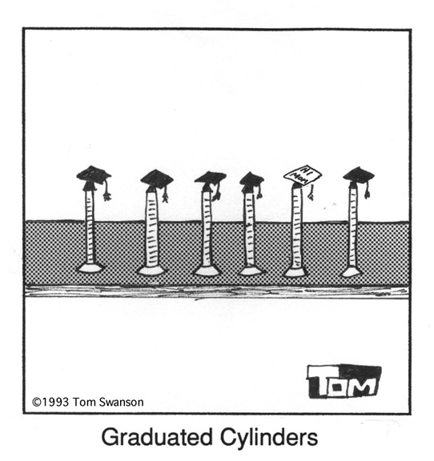

Slide 238
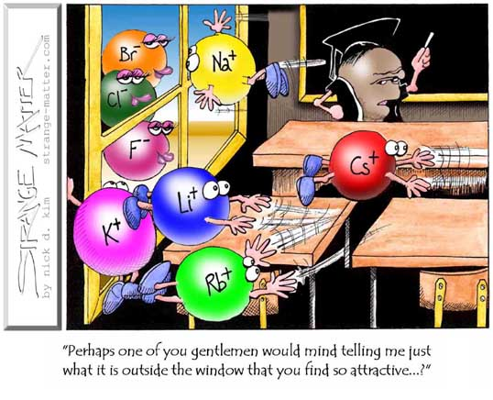

Slide 239
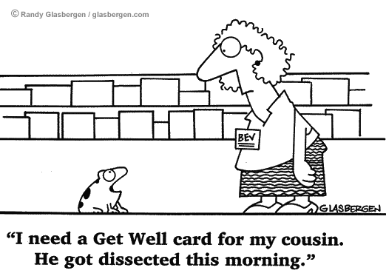

Slide 240
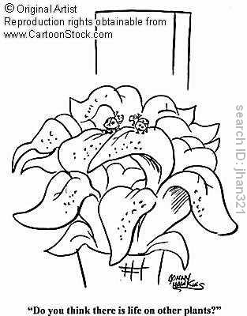

Slide 241
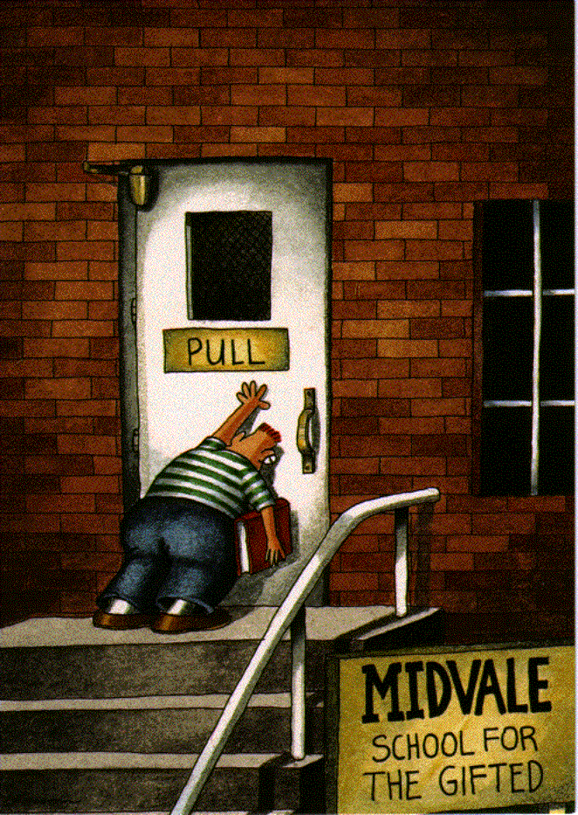

Slide 242
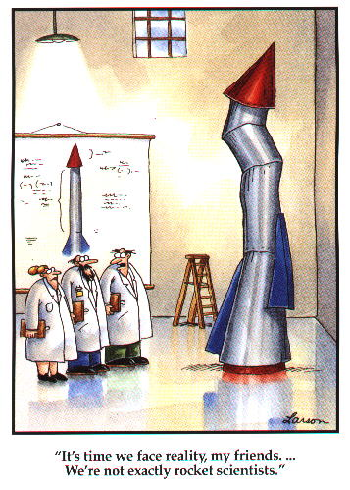

Slide 243
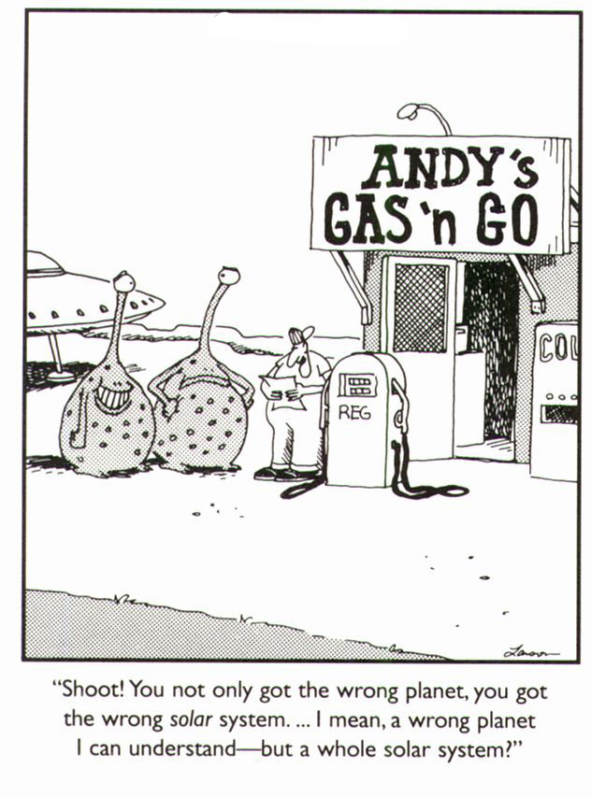

Slide 244
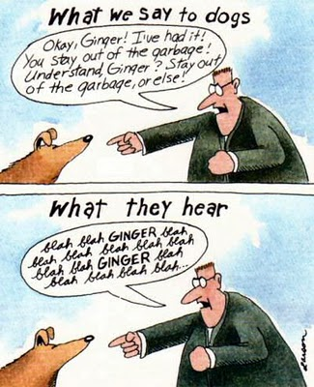

Slide 245
